Slide 1


9
8
7
6
5
4
3
2
1
10
0

Slide 2

Robotics Corner

Slide 3
Robotics Corner
Linux
Linux is an open Source operating system that is widely used in most of the companies.

Slide 4
01
What is and why Linux
02
History of Linux
AGEND
03
Linux Distributions
04
Basic Command line & Directory structure

Slide 5



Linux
Introduction to Linux OS
01285960031
01285960031
www.roboticscorner.tech

Slide 6



01
What is and why Linux
Definition
Linux is an open-source operating system kernel that manages hardware resources for software applications.
What is an Operating System?
An operating system (OS) is the fundamental software that manages computer hardware and software resources and provides common services for computer programs. It acts as an intermediary between users and the computer hardware.
Resource Management
User Interface
File System Management
Security and Access Control
Task Management
Examples of Operating Systems
01285960031
01285960031
www.roboticscorner.tech

Slide 7




01
What is and why Linux
Creation: Developed by Linus Torvalds in 1991 and distributed under the GNU General Public License.
Application
Core Components: Kernel, shell, GUI (optional), and various software packages.
Shell
Kernel
HW
Features of Linux
Open Source
Security
Stability
Flexibility
01285960031
01285960031
www.roboticscorner.tech

Slide 8




01
What is and why Linux
Why Choose Linux?
Cost: Free to use and distribute, with no licensing fees.
Community Support: A large community of developers and users offers support and frequent updates.
Customizability: Highly customizable and adaptable to specific needs.
Performance: Efficient resource management, suitable for servers and embedded systems.
01285960031
01285960031
www.roboticscorner.tech

Slide 9
02
History Of Linux
Unix Development at AT&T
Version 4 that was written in higher-level C
Version 6 was licensed for companies
BSD release
Release of MINIX
First Launch and written in assembly language
Licensed to educational institute (Version 5)
Last version of research Unix
GNU Project a Unix like operating system
Linux in created
01285960031
01285960031
www.roboticscorner.tech

Slide 10
02
History Of Linux
Unix Development at AT&T
Version 4 that was written in higher-level C
Version 6 was licensed for companies
BSD release
Release of MINIX
First Launch and written in assembly language
Licensed to educational institute (Version 5)
Last version of research Unix
GNU Project a Unix like operating system
Linux in created
Unix Development: Dennis Ritchie and Ken Thompson were the first to design an operating system named Unix after the Multi projects had been dropped out. In 1969, Unix was started as a small project at AT&T Bell Lab.
01285960031
01285960031
www.roboticscorner.tech

Slide 11
02
History Of Linux
Unix Development at AT&T
Version 4 that was written in higher-level C
Version 6 was licensed for companies
BSD release
Release of MINIX
First Launch and written in assembly language
Licensed to educational institute (Version 5)
Last version of research Unix
GNU Project a Unix like operating system
Linux in created
First Unix Version: The version of Unix was released in 1970 and written in assembly language. It was used for text processing.
01285960031
01285960031
www.roboticscorner.tech

Slide 12
02
History Of Linux
Unix Development at AT&T
Version 4 that was written in higher-level C
Version 6 was licensed for companies
BSD release
Release of MINIX
First Launch and written in assembly language
Licensed to educational institute (Version 5)
Last version of research Unix
GNU Project a Unix like operating system
Linux in created
Unix Development: Dennis Ritchie and Ken Thompson were the first to design an operating system named Unix after the Multi projects had been dropped out. In 1969, Unix was started as a small project at AT&T Bell Lab.
01285960031
01285960031
www.roboticscorner.tech

Slide 13
02
History Of Linux
Unix Development at AT&T
Version 4 that was written in higher-level C
Version 6 was licensed for companies
BSD release
Release of MINIX
First Launch and written in assembly language
Licensed to educational institute (Version 5)
Last version of research Unix
GNU Project a Unix like operating system
Linux in created
Fourth Version: This Unix version was written in a Higher level of C language which was portable and it was released in 1973.
01285960031
01285960031
www.roboticscorner.tech

Slide 14
02
History Of Linux
Unix Development at AT&T
Version 4 that was written in higher-level C
Version 6 was licensed for companies
BSD release
Release of MINIX
First Launch and written in assembly language
Licensed to educational institute (Version 5)
Last version of research Unix
GNU Project a Unix like operating system
Linux in created
Fifth Version: The fifth version was released in 1973 which was the first version that was licensed for the educational institute.
01285960031
01285960031
www.roboticscorner.tech

Slide 15
02
History Of Linux
Unix Development at AT&T
Version 4 that was written in higher-level C
Version 6 was licensed for companies
BSD release
Release of MINIX
First Launch and written in assembly language
Licensed to educational institute (Version 5)
Last version of research Unix
GNU Project a Unix like operating system
Linux in created
Sixth Version: The sixth version was released in 1975 and this version was licensed for the companies, it was the version from which the first BSD was derived.
01285960031
01285960031
www.roboticscorner.tech

Slide 16
02
History Of Linux
Unix Development at AT&T
Version 4 that was written in higher-level C
Version 6 was licensed for companies
BSD release
Release of MINIX
First Launch and written in assembly language
Licensed to educational institute (Version 5)
Last version of research Unix
GNU Project a Unix like operating system
Linux in created
Last developed version: The seventh edition of Unix is the official last version that was developed under the Bell Lab which later developed the Unix and Unix-like operating system carried forward by other open-source and commercial branches.
01285960031
01285960031
www.roboticscorner.tech

Slide 17
02
History Of Linux
Unix Development at AT&T
Version 4 that was written in higher-level C
Version 6 was licensed for companies
BSD release
Release of MINIX
First Launch and written in assembly language
Licensed to educational institute (Version 5)
Last version of research Unix
GNU Project a Unix like operating system
Linux in created
BSD Release: Berkeley released a free Unix-like operating system that was named Berkeley Software Distribution (BSD) in 1977. It was sued because its code was replicated from Unix.
01285960031
01285960031
www.roboticscorner.tech

Slide 18
02
History Of Linux
Unix Development at AT&T
Version 4 that was written in higher-level C
Version 6 was licensed for companies
BSD release
Release of MINIX
First Launch and written in assembly language
Licensed to educational institute (Version 5)
Last version of research Unix
GNU Project a Unix like operating system
Linux in created
GNU Project: In 1983, Stallman introduced the GNU operating system which was a free Unix-like operating system and he also wrote the GNU General Public License that successfully attracted developers. But its kernel was not that developed so the project was not further proceeded.
01285960031
01285960031
www.roboticscorner.tech

Slide 19
02
History Of Linux
Unix Development at AT&T
Version 4 that was written in higher-level C
Version 6 was licensed for companies
BSD release
Release of MINIX
First Launch and written in assembly language
Licensed to educational institute (Version 5)
Last version of research Unix
GNU Project a Unix like operating system
Linux in created
Release of MINIX: In 1987, a Unix-like operating system was released by Andrew S. Tanenbaum. It was only used for academic purposes which was available but the modification of the code was restricted.
01285960031
01285960031
www.roboticscorner.tech

Slide 20
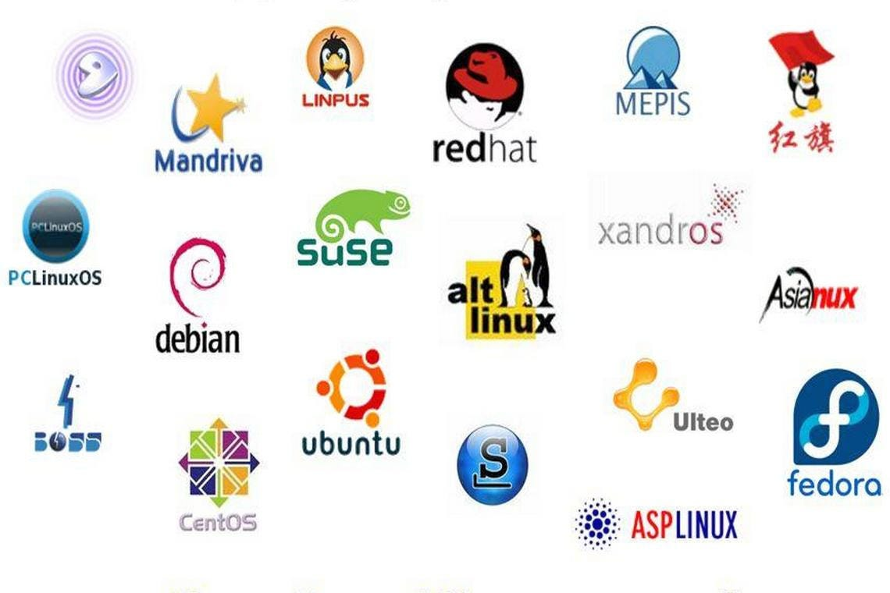
03
Linux Distributions
Ubuntu
Fedora
Arch
Plasma
KDE
Mint
Manjaro
Basic: Linux Mint, Ubuntu, Elementary OS or Deepin.
Above-average: Debian or Fedora
Challenging: Gentoo
01285960031
01285960031
www.roboticscorner.tech

Slide 21
04
Basic Command line & Directory structure
ls Lists a directory’s content
cd Changes the working directory
pwd Shows the current working directory’s path
mkdir Creates a new directory
rmdir remove a directory
whatis Tells what a specific command does
man Manual for a particular command
touch Create a file
cp Copy
mv Move(Cut)
rm Remove
01285960031
01285960031
www.roboticscorner.tech

Slide 22
04
Basic Command line & Directory structure
cd .. : Jumps 1 directory back
cd ../ : Jumps 2 directories back
cd : goes to the home directory
The man command is a built-in manual for using Linux commands. It allows users to view the reference manuals of a command or utility run in the terminal. The man page (short for manual page) includes a command description, applicable options, flags, examples, and other informative sections.
man ls, man pwd, etc…
Press Q to exit the manual
01285960031
01285960031
www.roboticscorner.tech

Slide 23
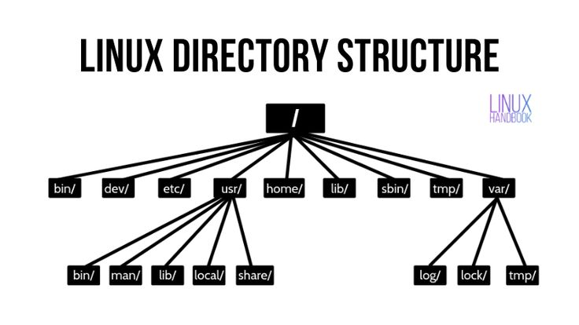
04
Basic Command line & Directory structure
General Files – It is also called ordinary files. It may be an image, video, program, or simple text file. These types of files can be in ASCII or Binary format. It is the most commonly used file in the Linux system.
Directory Files –It may be a directory file within a directory (subdirectory).
Device Files – In a Windows-like operating system, devices like CD-ROM, and hard drives are represented as drive letters like F: G: H whereas in the Linux system devices are represented as files. As for example, /dev/sda1, /dev/sda2, and so on.
01285960031
01285960031
www.roboticscorner.tech

Slide 24
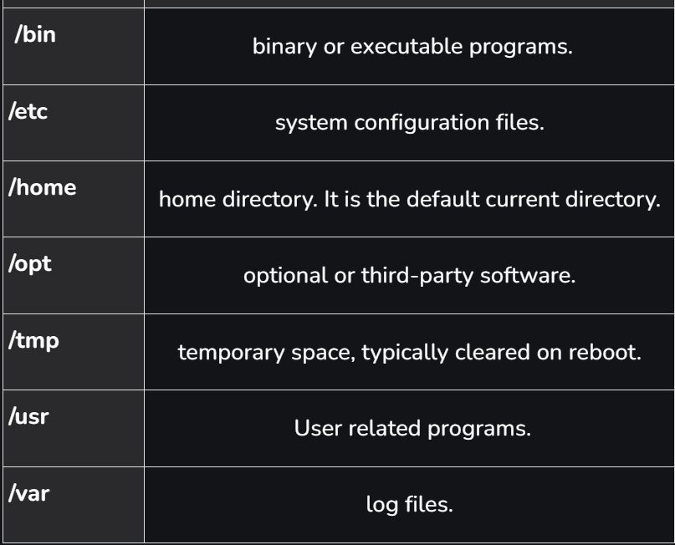
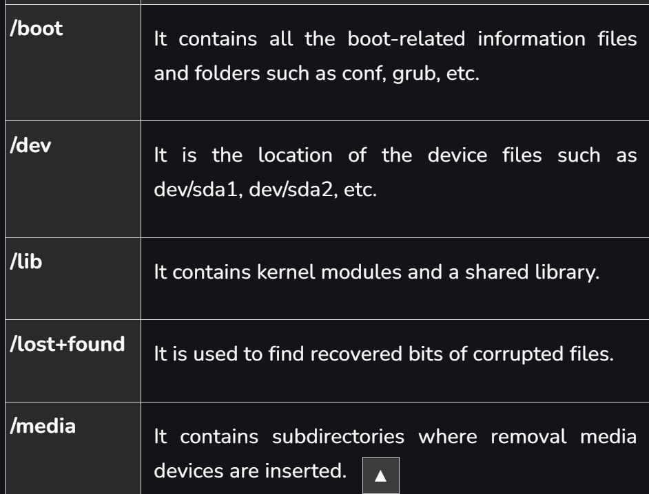
04
Basic Command line & Directory structure
Directory Structure in Linux
01285960031
01285960031
www.roboticscorner.tech

Slide 25
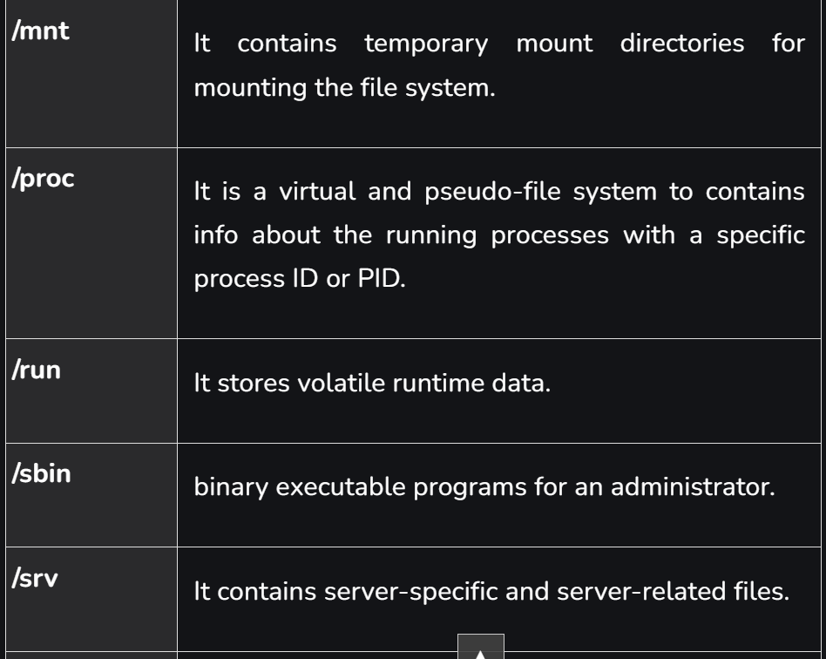
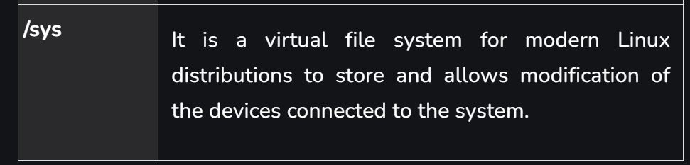
04
Basic Command line & Directory structure
01285960031
01285960031
www.roboticscorner.tech

Slide 26


Slide 27

01211626904
www.roboticscorner.tech
Robotics Corner
Robotics Corner
Robotics Corner
Robotics Corner

